Slide 1
Homework 4 – Adaptive Controller Design
Yi Chen
3/21/2020

Slide 2
Control objective
Indirect adaptive controller for PPC and LQG methods
Direct adaptive control for MPC
Compare fixed controller versus adaptive controller and see if adaptive controller converges to fixed ones.
Note from professor:
Now you need to get more concise. You are plotting responses and there are too many cases without comments.
There should not be a non adaptive controller that is unstable.
The idea is to design them well, since you know the plant.
Then you can ask the adaptive controller to converge to the same response.
Your final conclusion shows the misconception.
You should not be comparing adaptive and non-adaptive transients but if the adaptive finally converges to the nonadaptive.

Slide 3
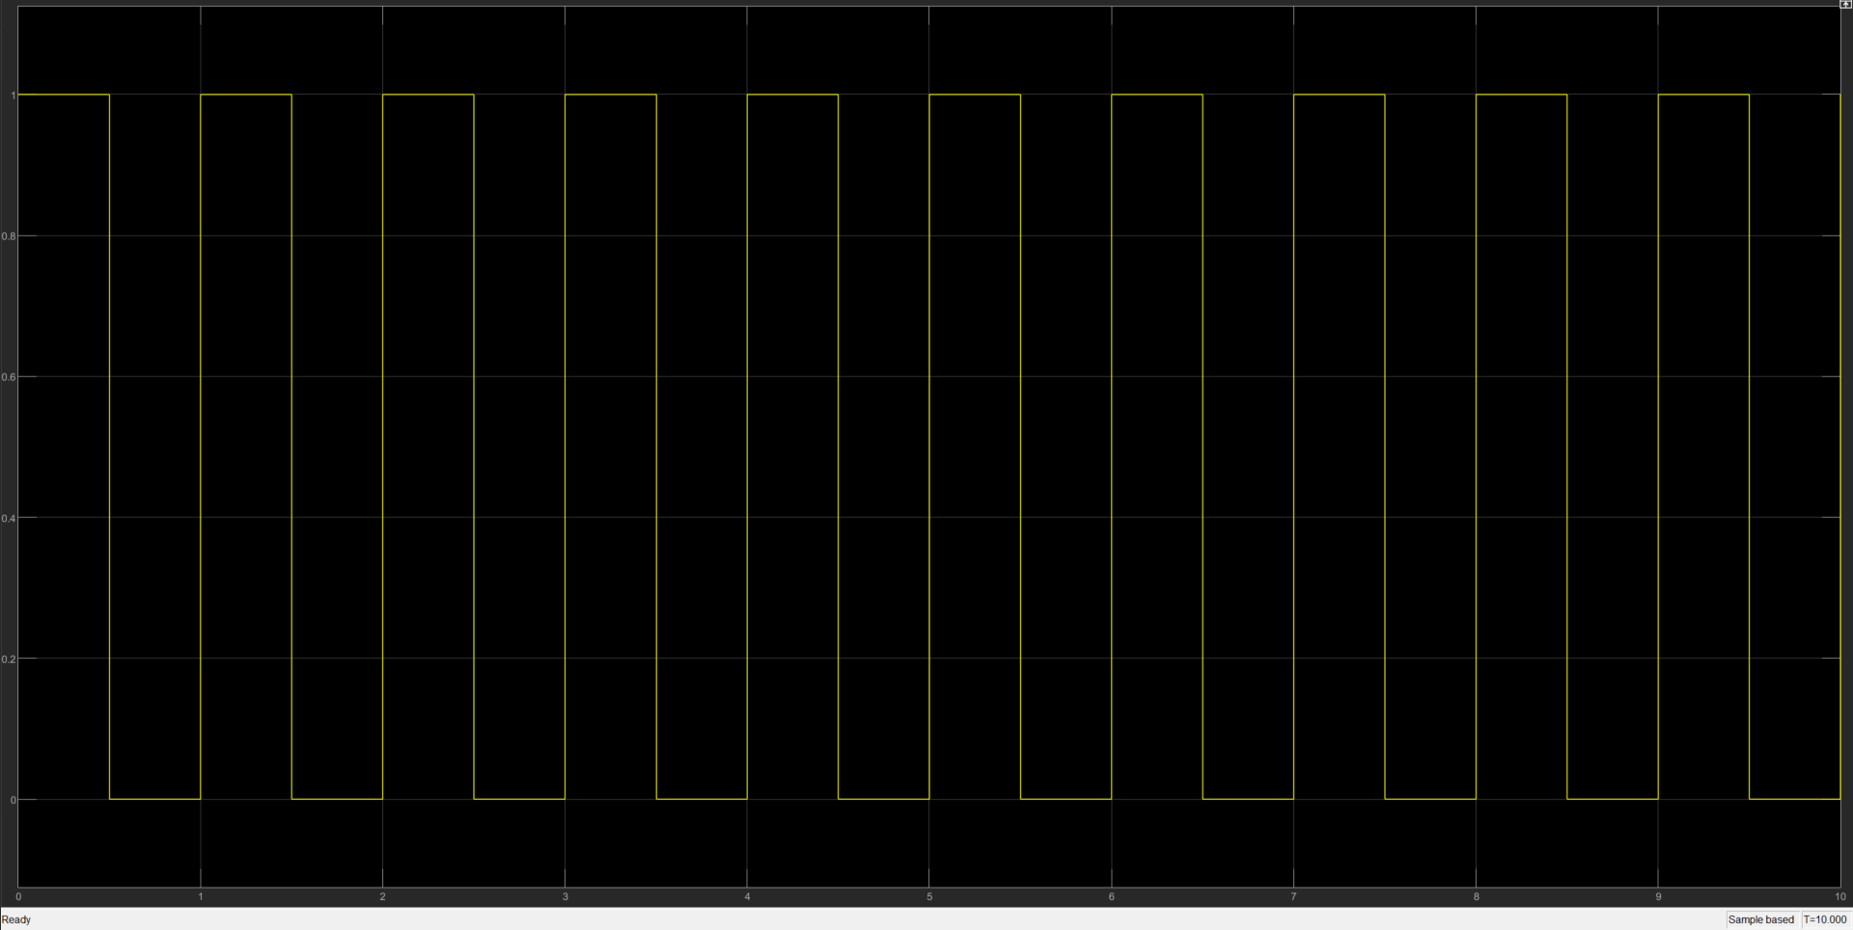
Reference input
frequency: 1 Hz, amplitude: 1

Slide 4
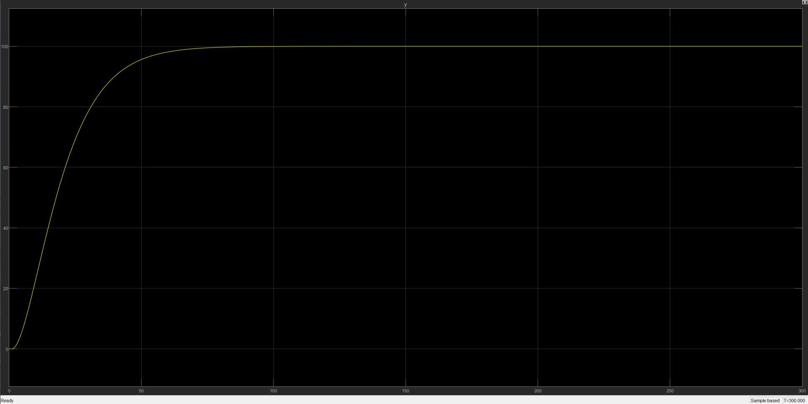
Open-loop Plant 1
Given step input

Slide 5
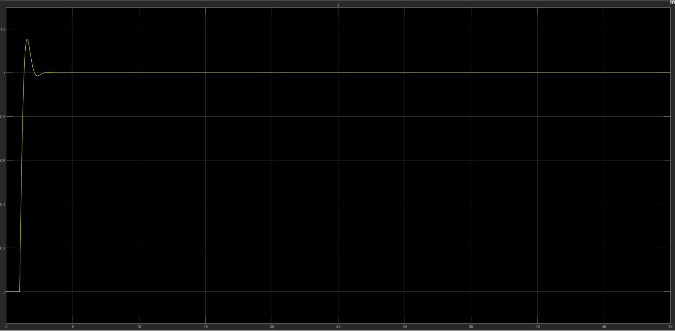
Open-loop Plant 2
Given unit step input
Overshoot is about 11%
Settling time is about 3 seconds

Slide 6
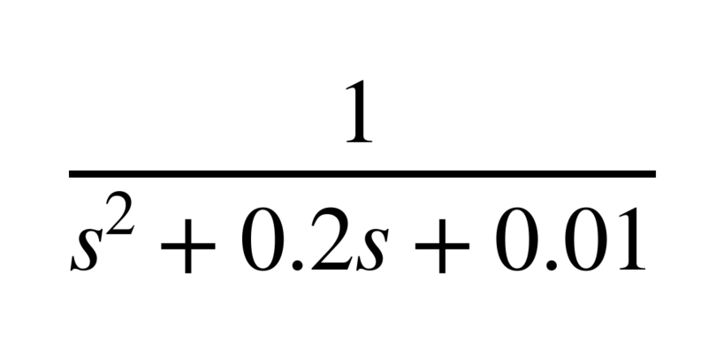
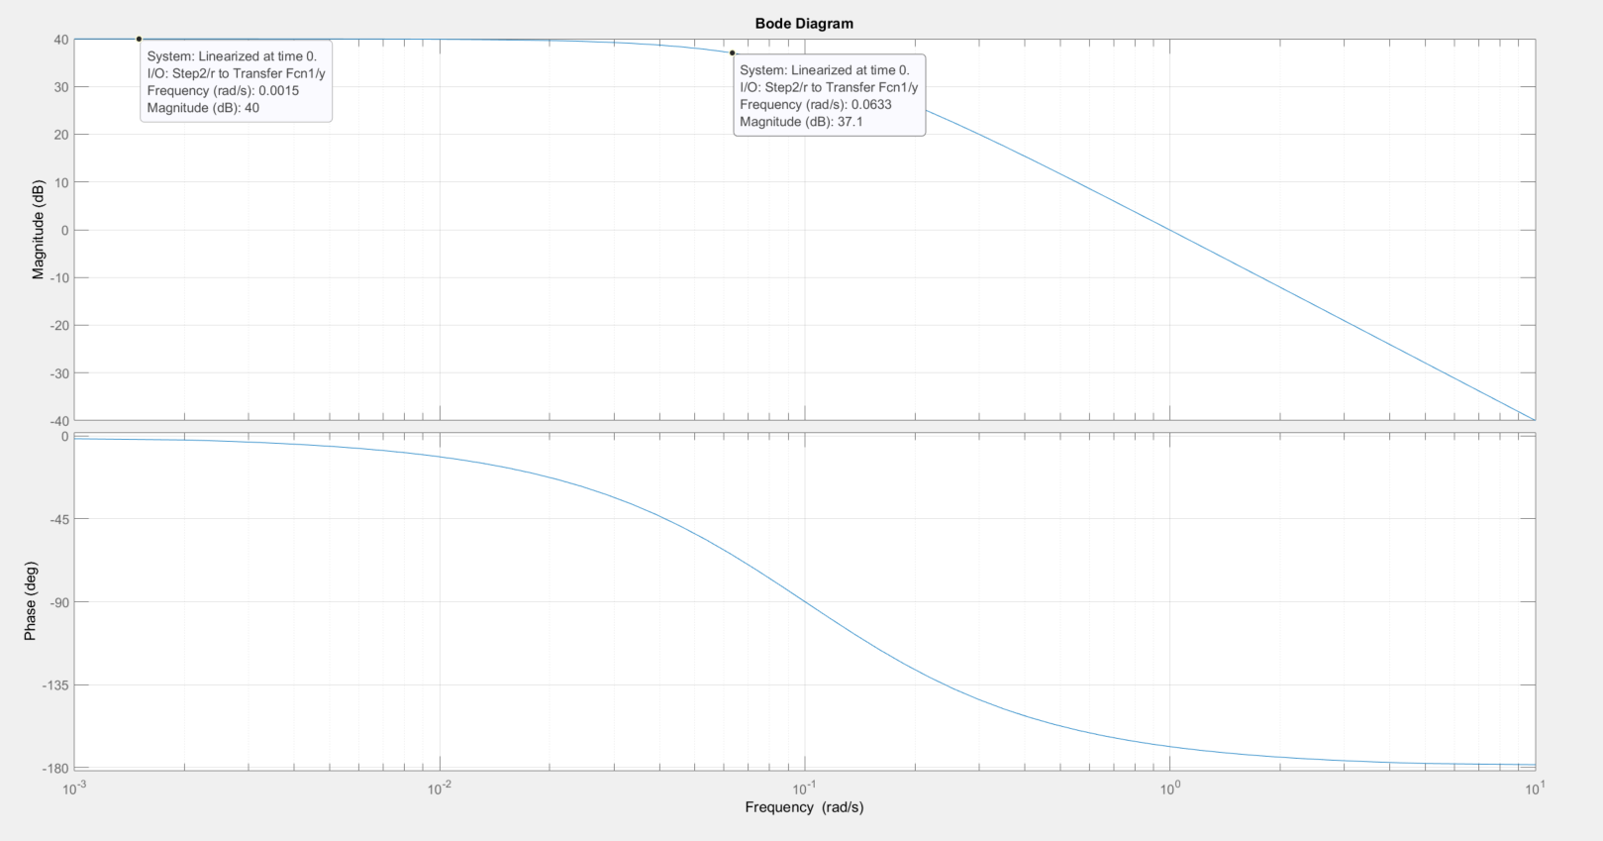
Plant 1:
P =
Open loop pole: -0.1, -0.1
Open loop bandwidth: 0.0633
Settling time: 75s
Overshoot: 0
Controllable: yes
Observable: yes

Slide 7
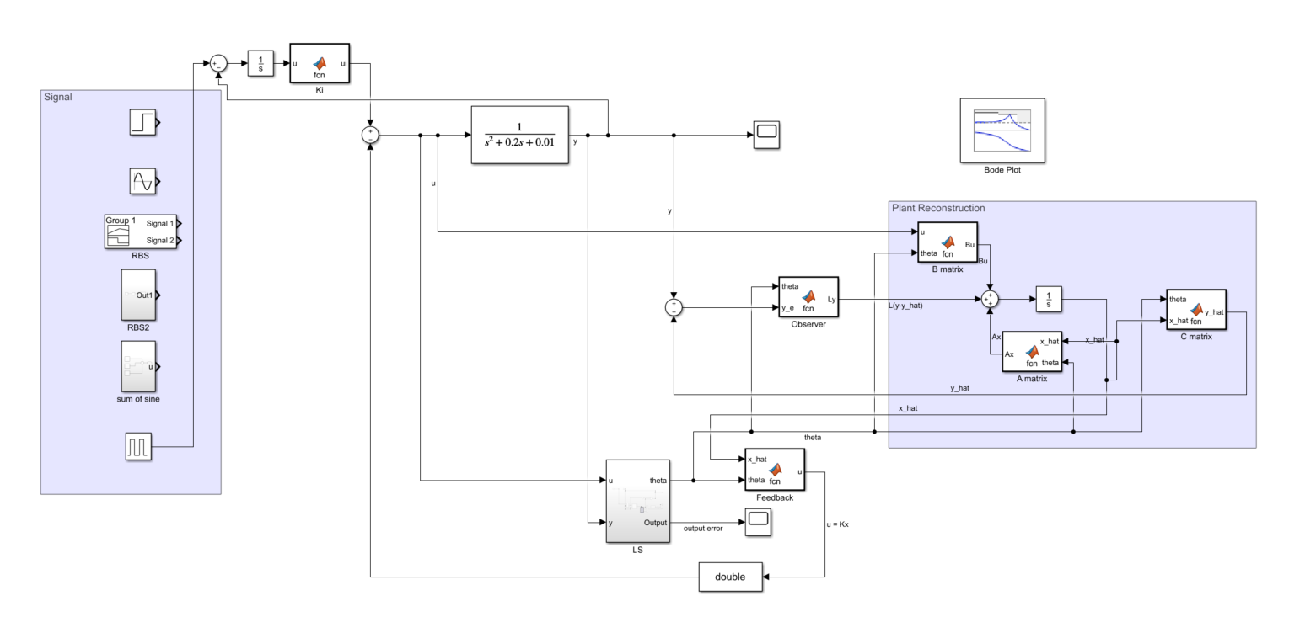
PPC – setup (adaptive): Least Square

Slide 8
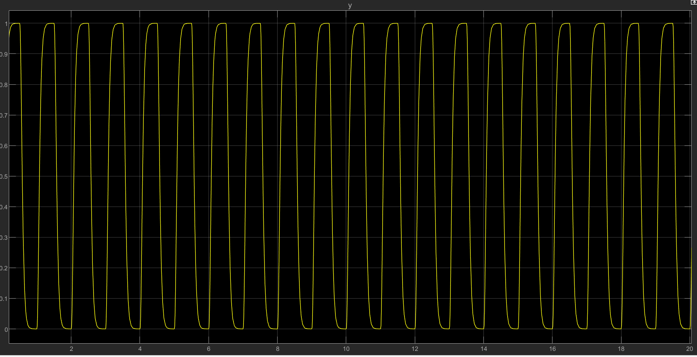
PPC – P1 – System response – non-adaptive
Poles: -30+0.69805i ,-30-0.69805i ,-50
Designed be fast enough to track input reference signal

Slide 9
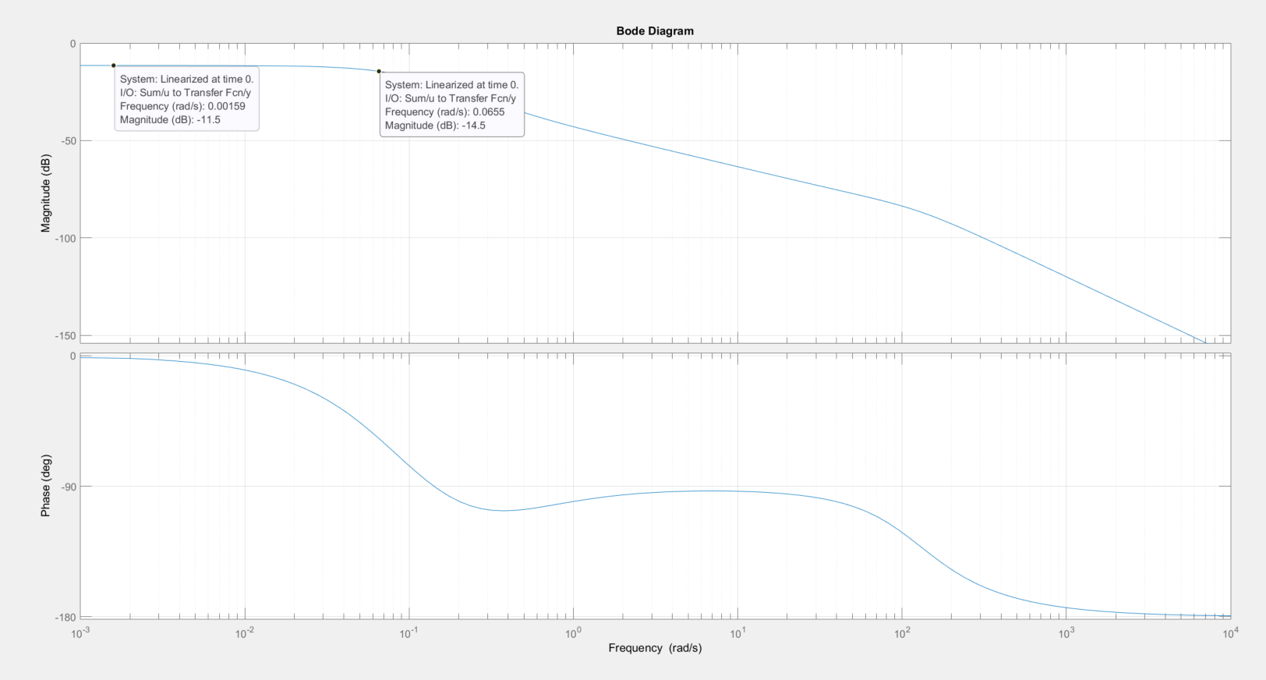
PPC –Frequency response
With K designed having pole = -30+0.69805i -30-0.69805i
Pole for Ki = -50
Bandwidth = 0.0655

Slide 10
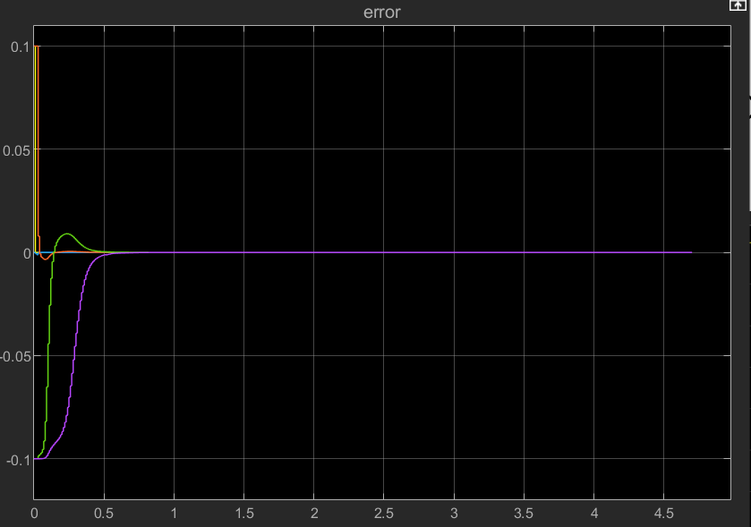
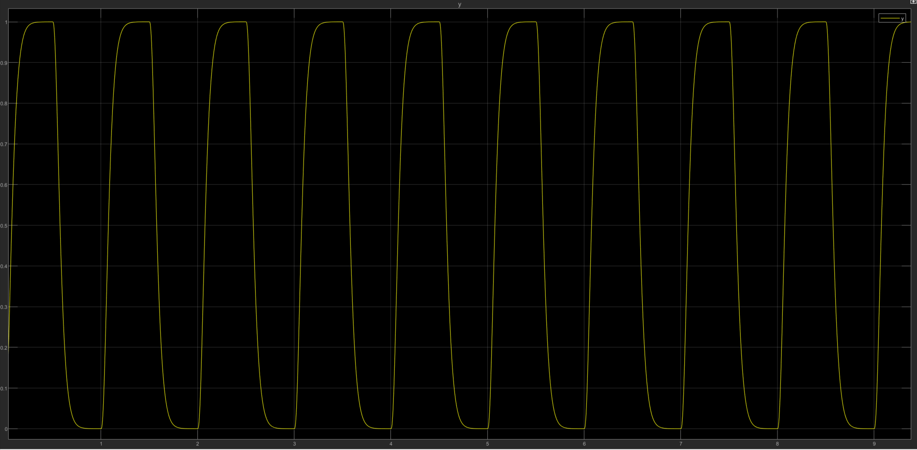
PPAC– System response
Initial param: [0.1, 0, 1.1, 0.1, 0.1]
Error converges

Slide 11
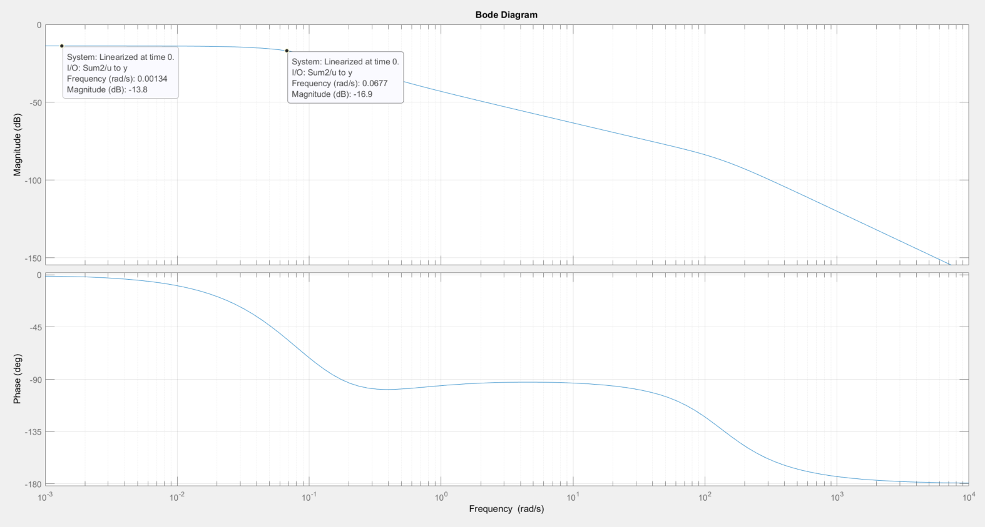
PPAC– Frequency response
With K designed having pole = -30+0.69805i & -30-0.69805i
Pole for Ki = -50
Bandwidth = 0.0677

Slide 12
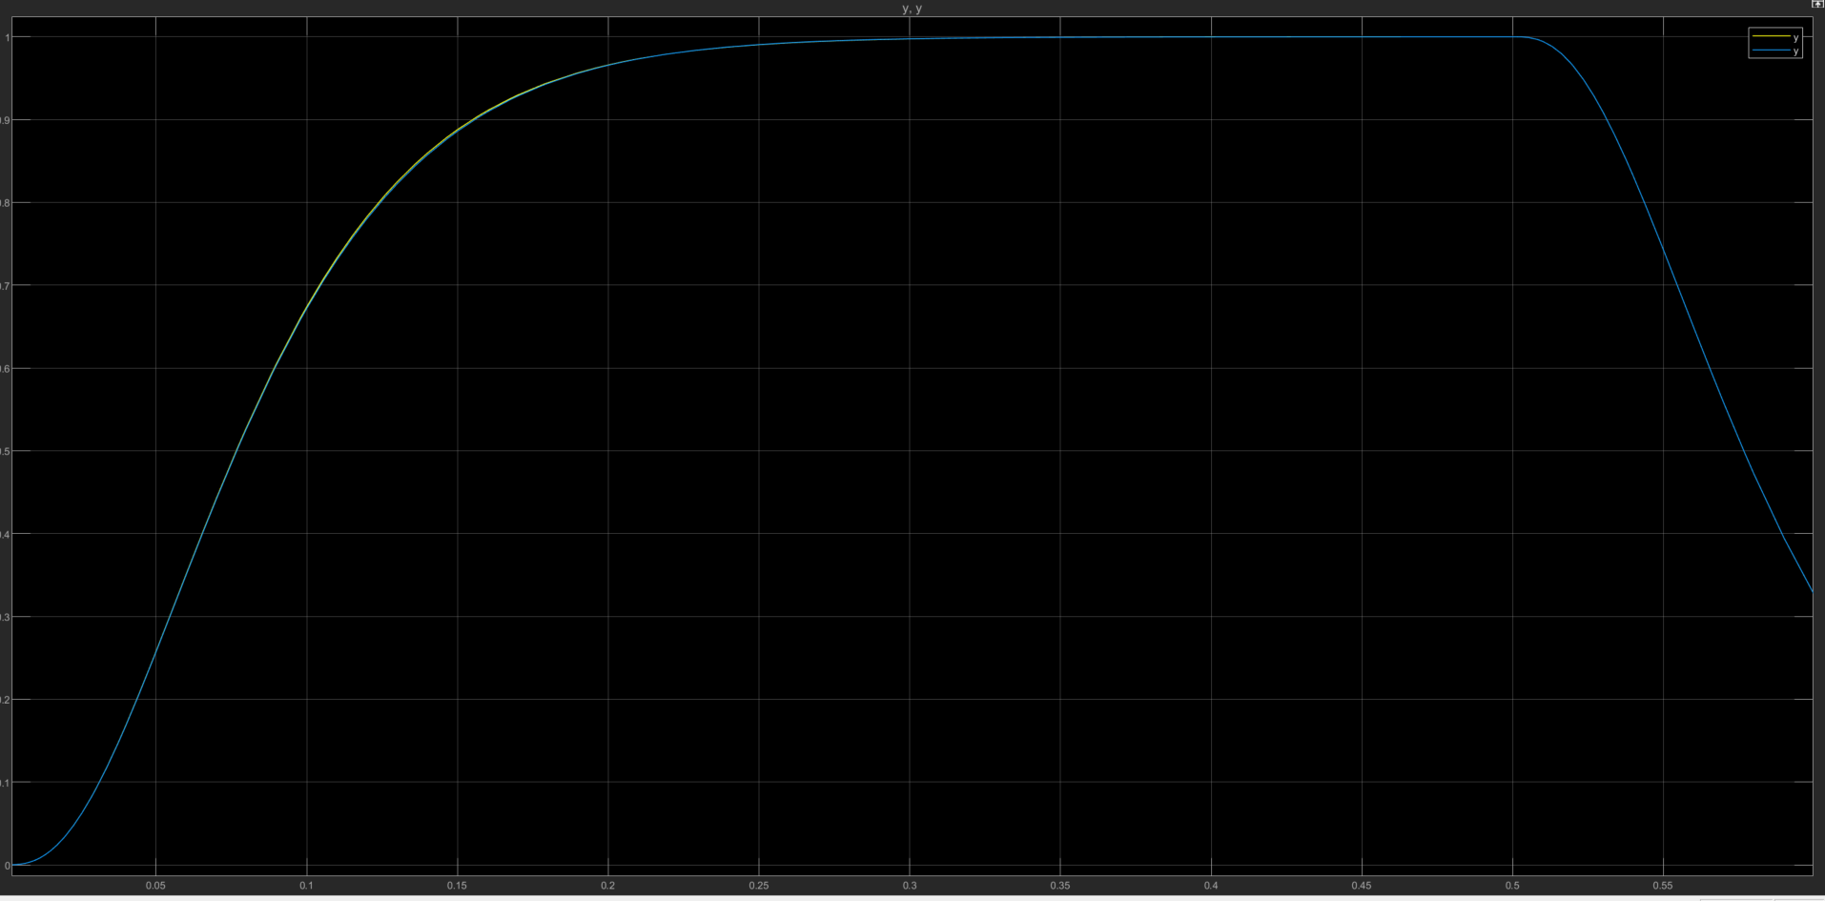
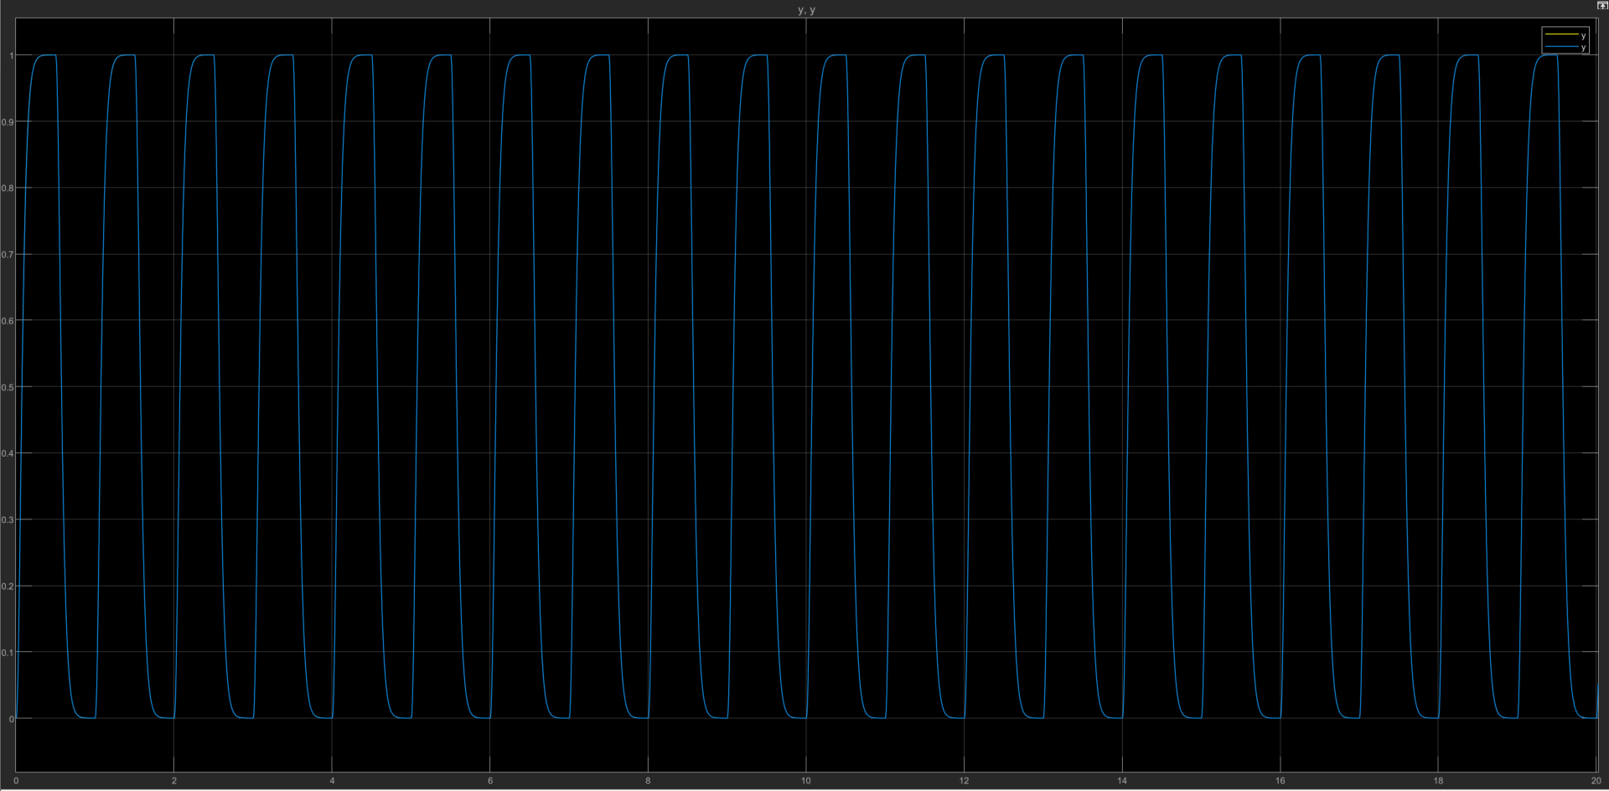
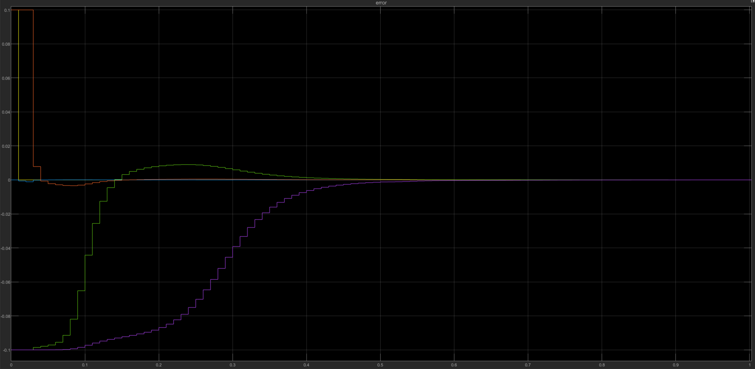
PPAC vs PPC comparison – Plant 1
Yp vs Yp fixed: First 1 second only small difference
Yp vs Yp fixed
Theta_error: Converges within the first second

Slide 13
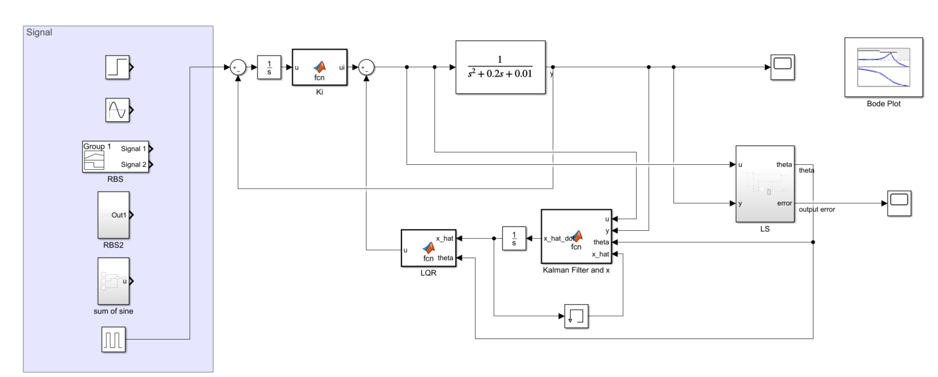
LQG – system setup - Adaptive
Indirect controller (LS algorithm) was implemented

Slide 14
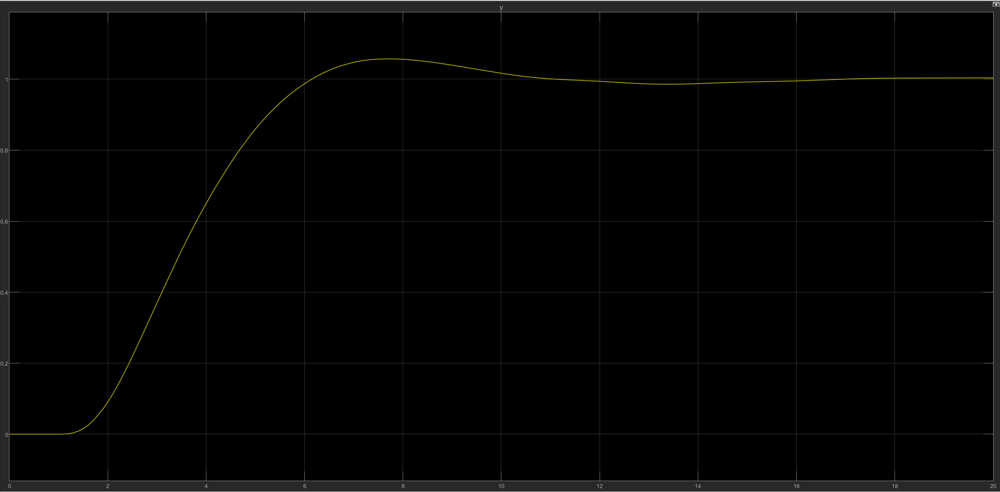
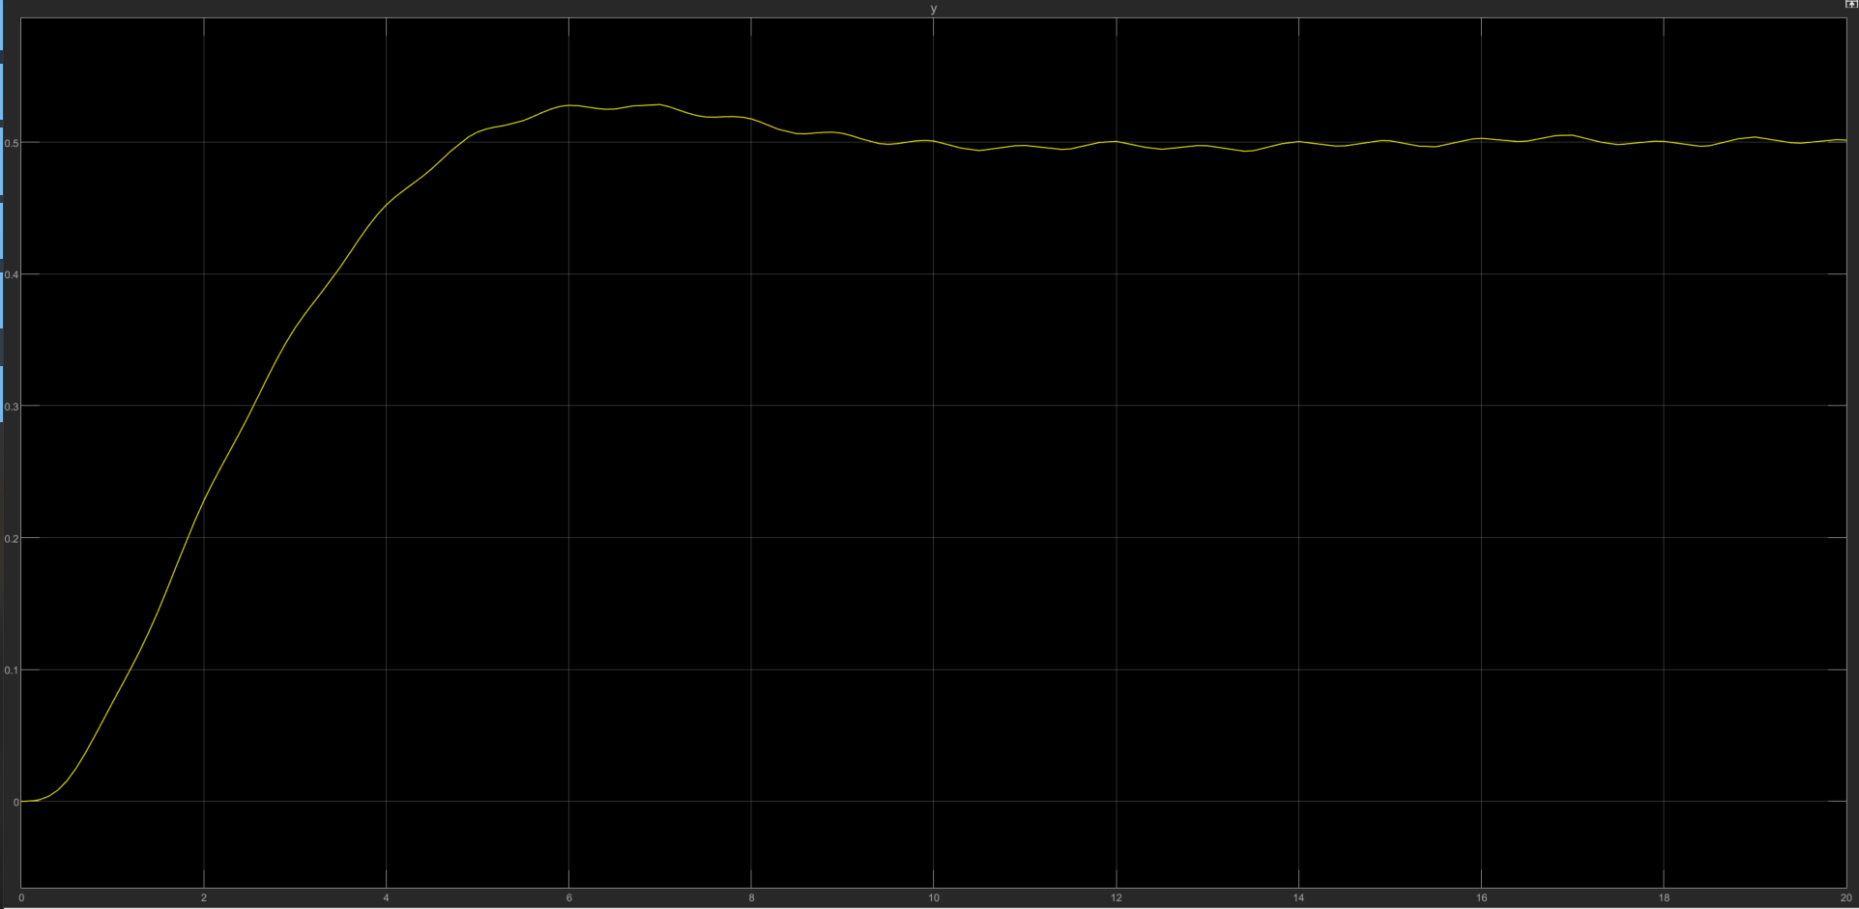
LQG – P1 – system response (non-adaptive)
1 →
R = 1
Q = I
KF: Q=R=10
System output given step input
0.5 →
System output given Pulse input

Slide 15
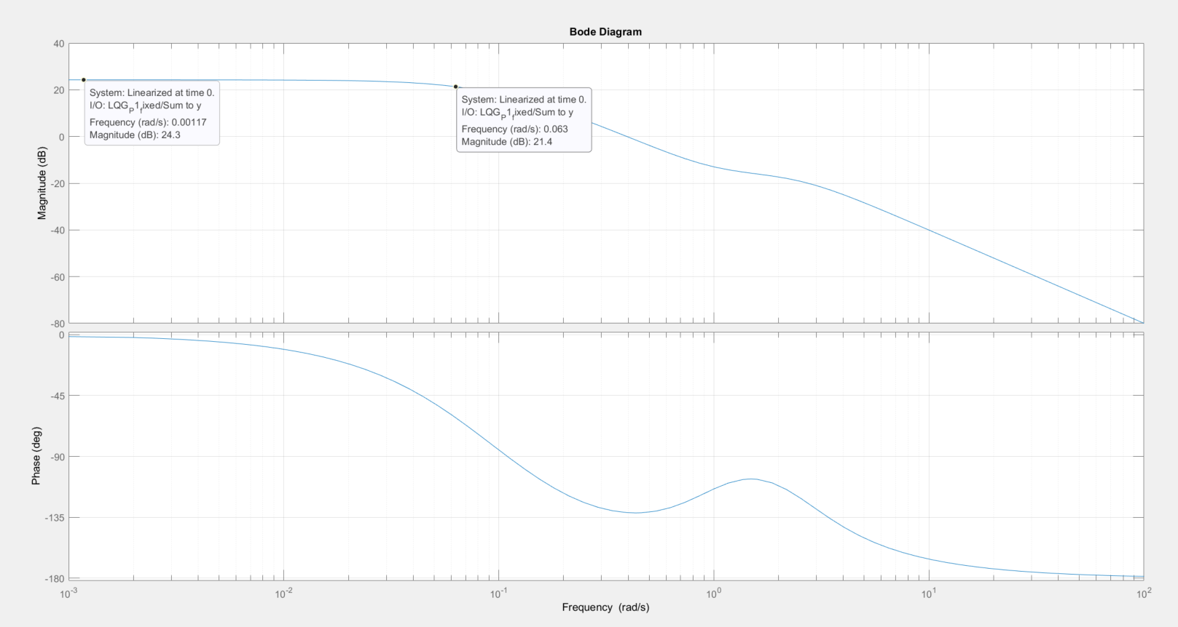
LQG – P1 – Frequency response (non-adaptive)
Bandwidth: 0.063

Slide 16
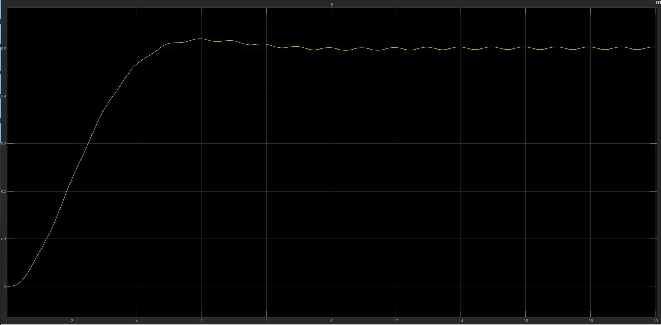
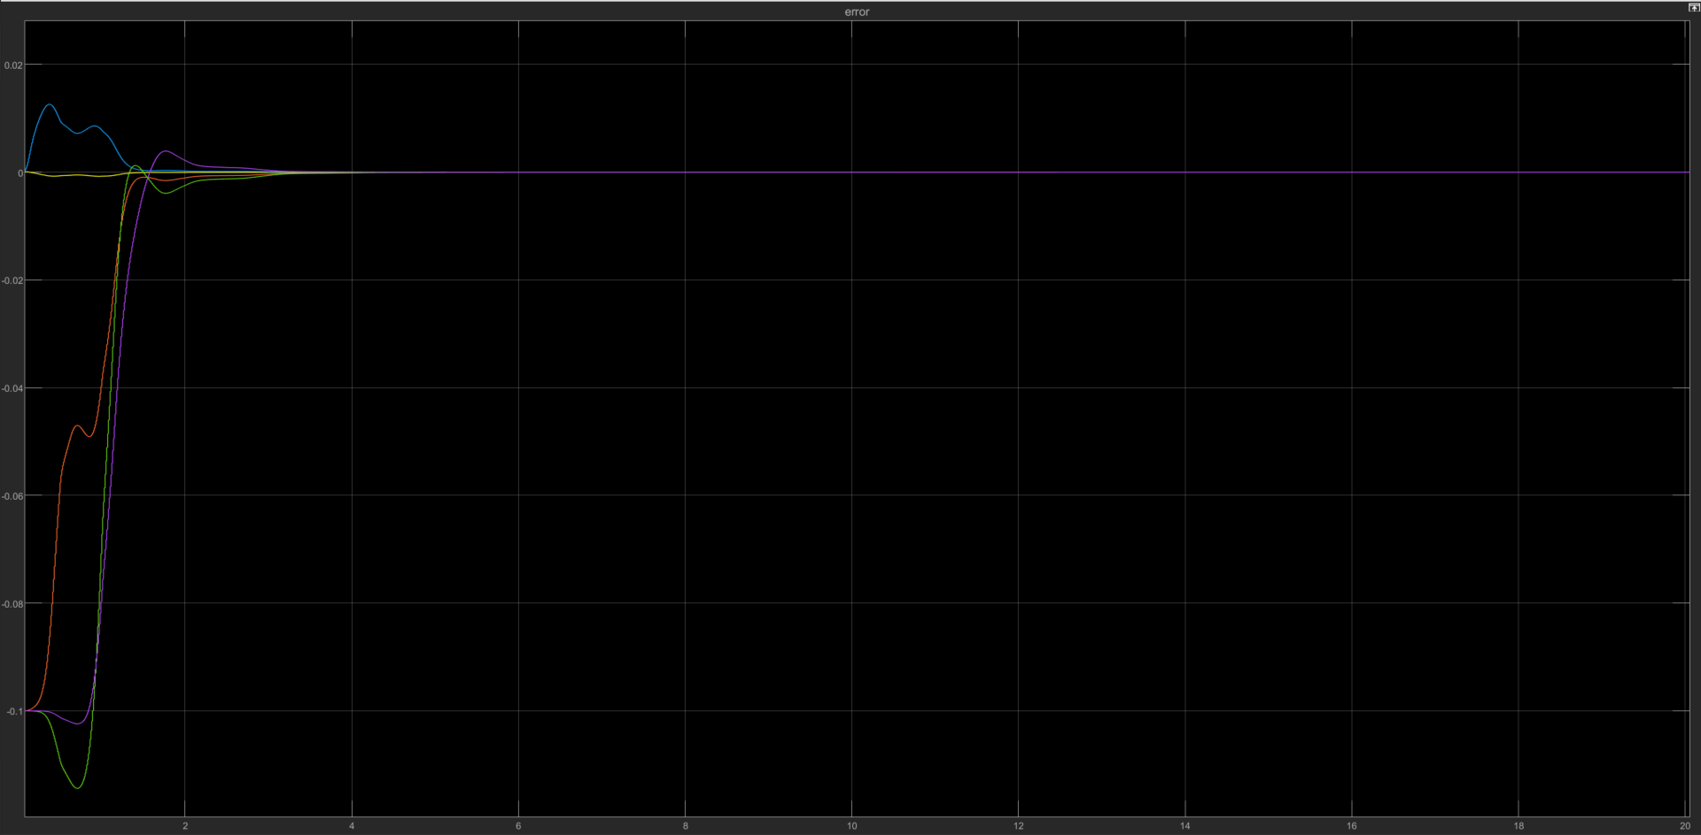
LQG – P1 – system response (adaptive)
Step size = 0.01s
Q=I, R = 1
Param error converges
System output given Pulse input

Slide 17
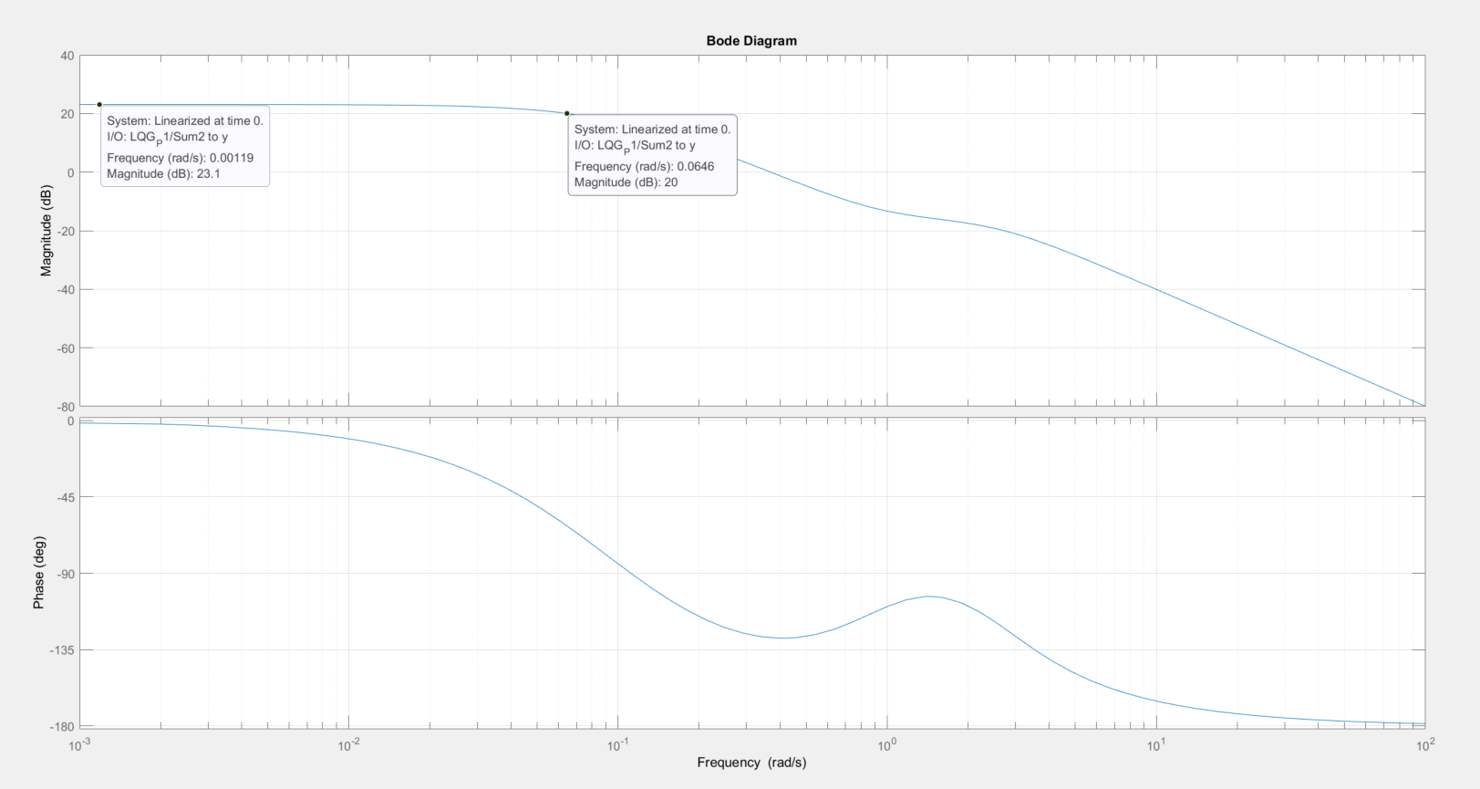
LQG – P1 – Frequency response - adaptive
#TODO
Bandwidth: 0.0646

Slide 18
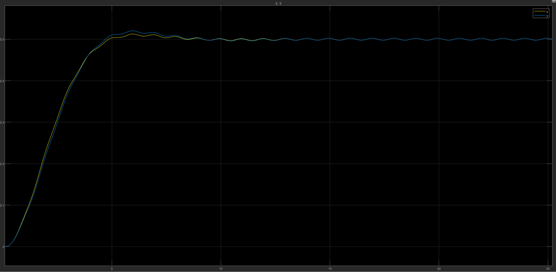
Adaptive LQG vs LQG comparison – Plant 1
Yp vs Yp fixed: converges around 13 seconds
Theta_error: Converges at about 4 seconds

Slide 19
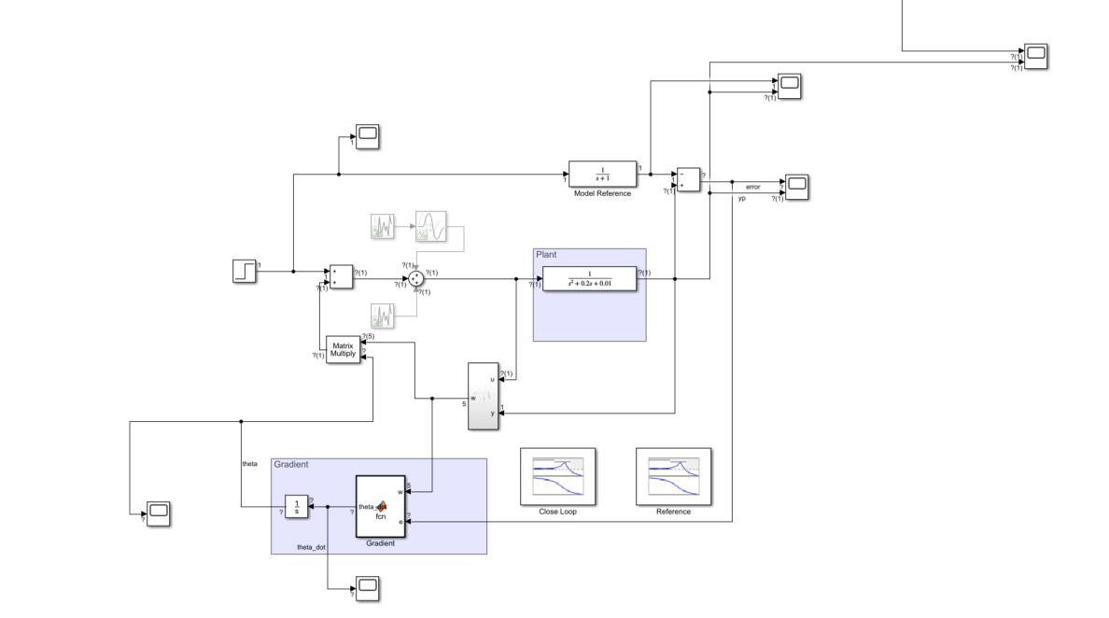
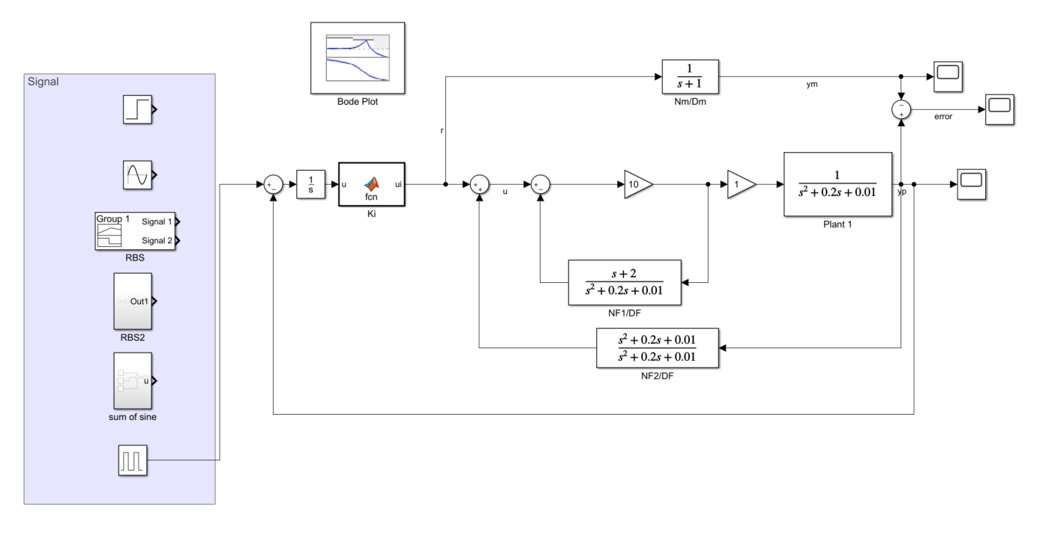
MRC – system setup
MRAC
MRC

Slide 20
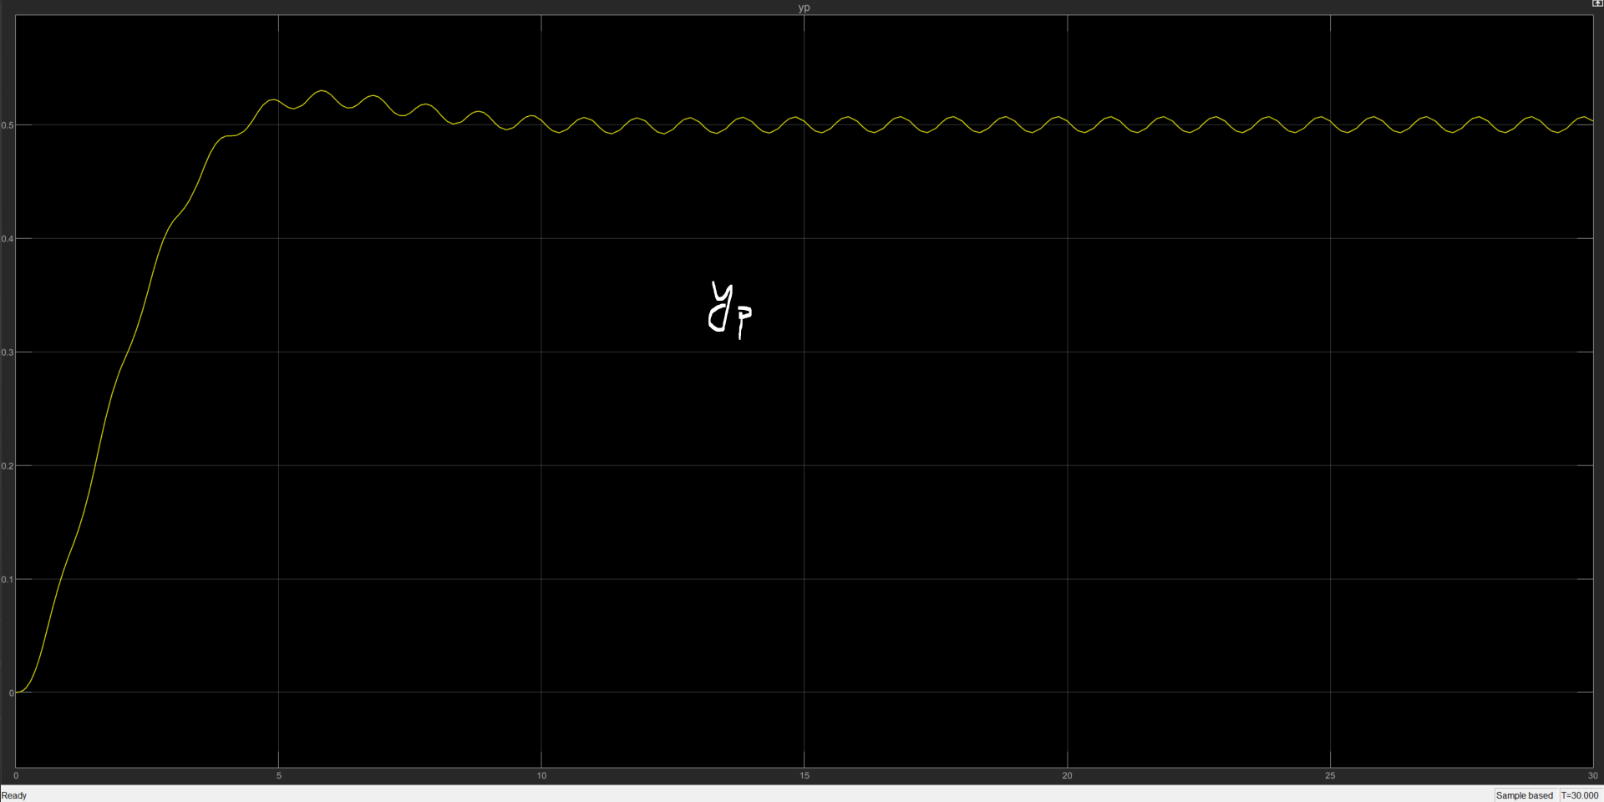
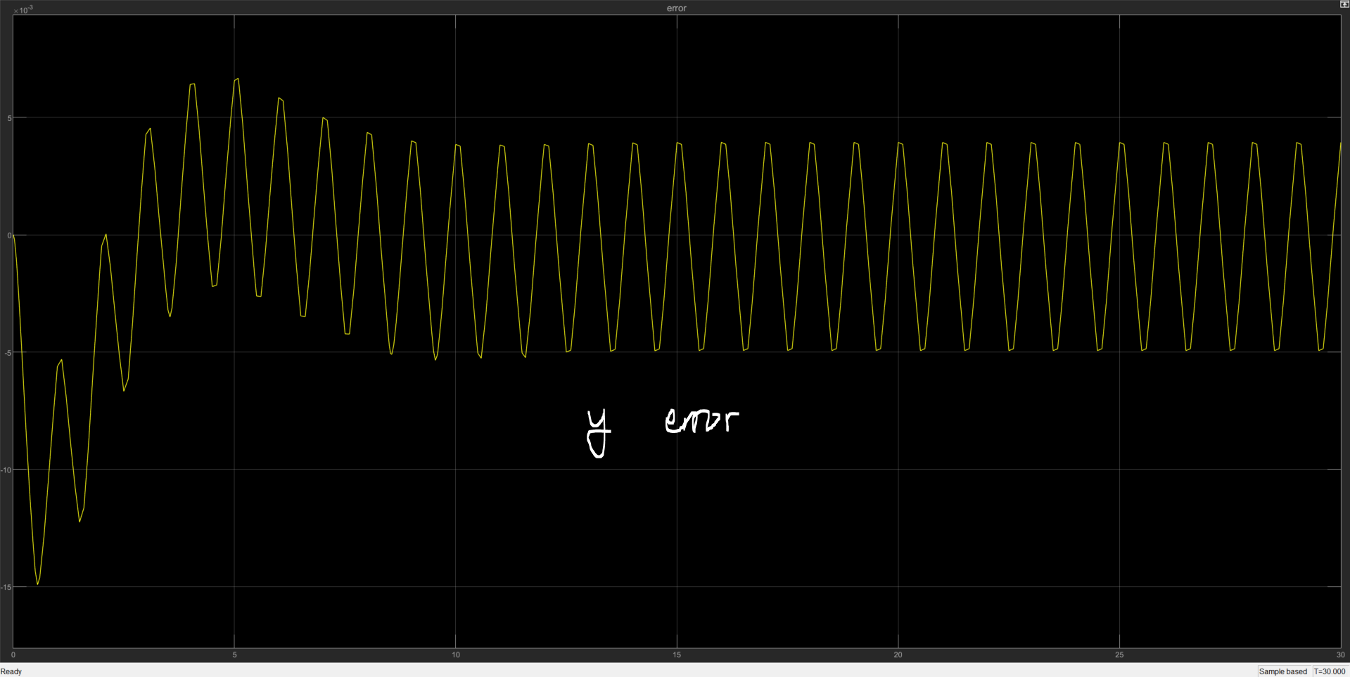
MRC – P1 – System response – non-adaptive
The system was given a pulse train input
The error to reference model are small (<0.5)

Slide 21
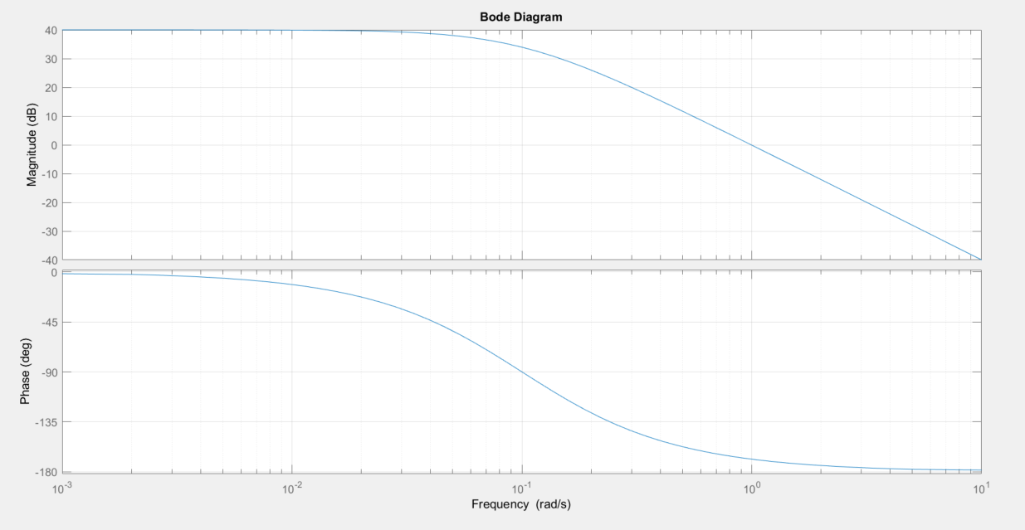
MRC – P1 – Frequency response – non-adaptive
#TODO
Desired bandwidth: 1 rad/s

Slide 22
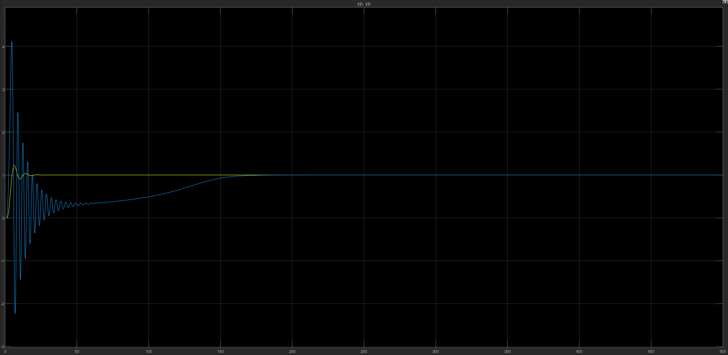
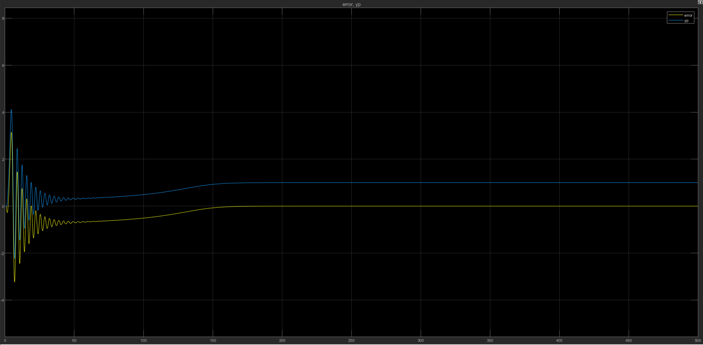
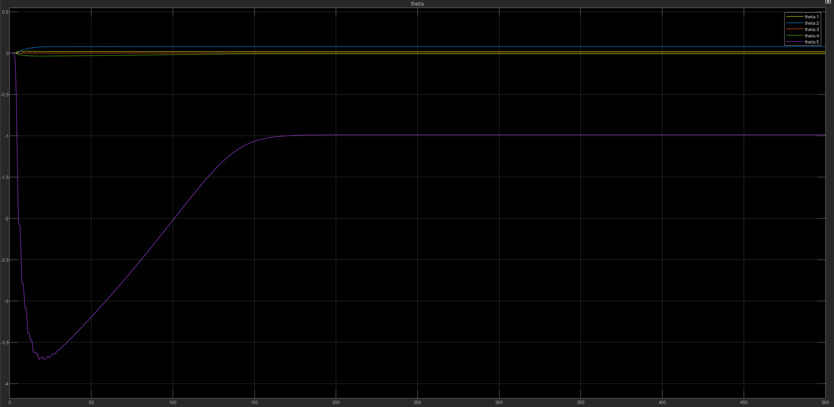
MRAC – P1
#TODO: where should the
param converge to?
Param converge to:
[0.017 0.078 0 -0.01 -1]
This trial was given a step input
The adaptive system output
converge to the non-adaptive MRC
The adaptive system output error
converge to zero (yellow)

Slide 23
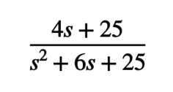
Plant 2:
P =
Open loop pole: -3+
Open loop bandwidth:
Settling time: 3%
Overshoot: 11%
Controllable: yes
Observable: yes

Slide 24
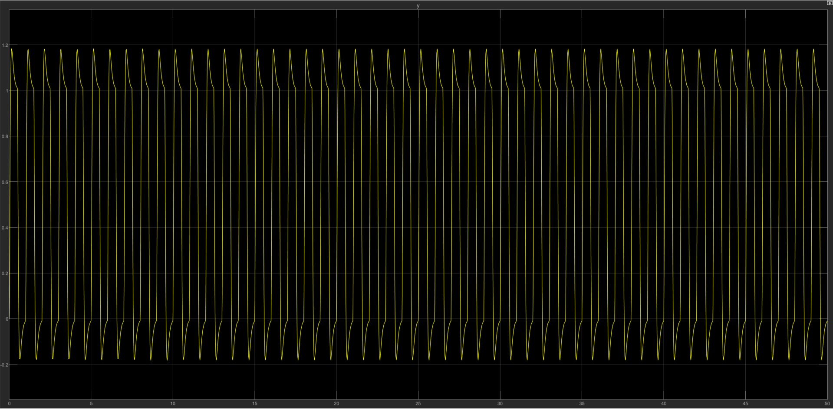
PPC – P2 – System response - non-adaptive
Poles are designed to be [-30+4i, -30-4i, -10], 10 times farther from open loop pole
Reference input is pulse train

Slide 25
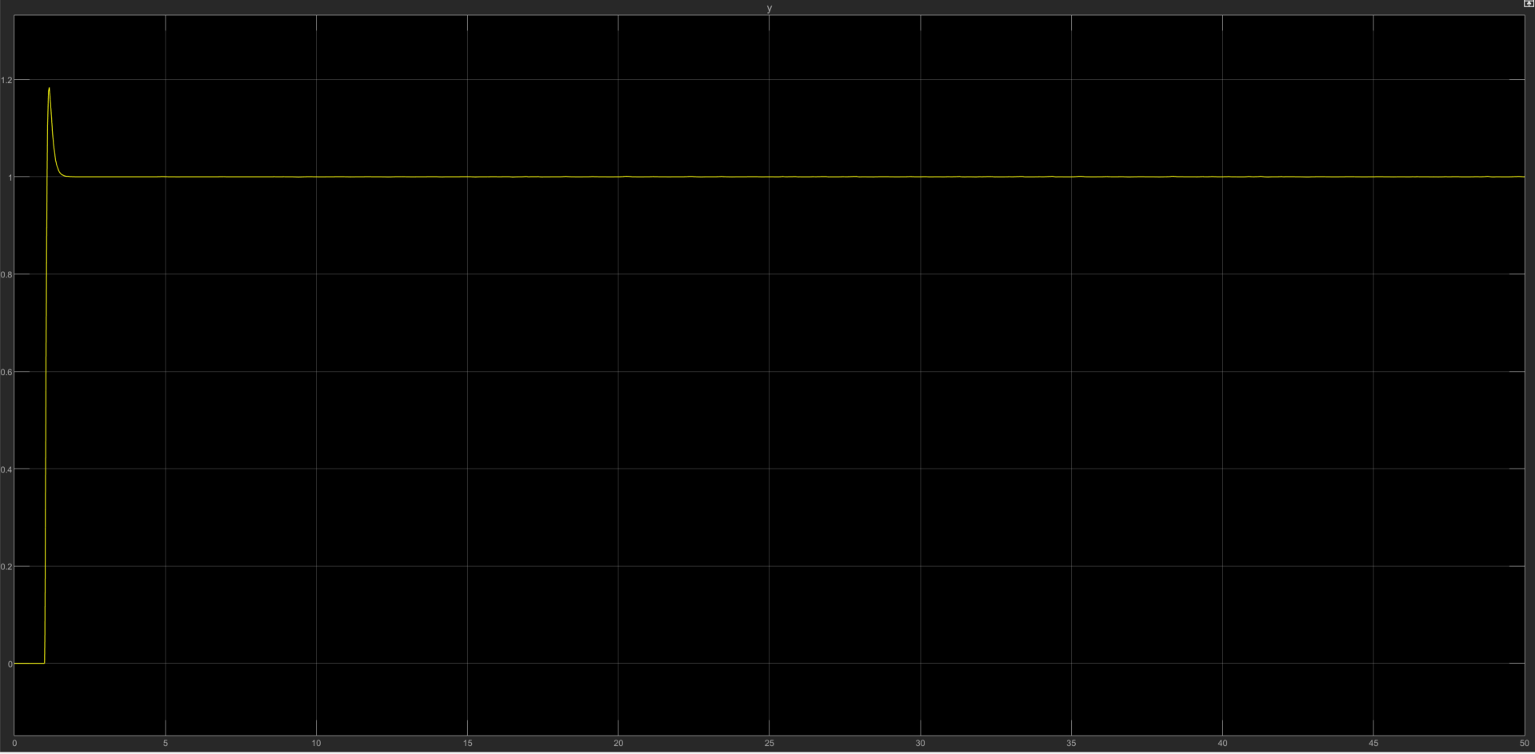
PPC – P2 – System response
Poles are designed to be [-30+4i, -30-4i, -10], 10 times farther from open loop pole
Reference input is a step

Slide 26
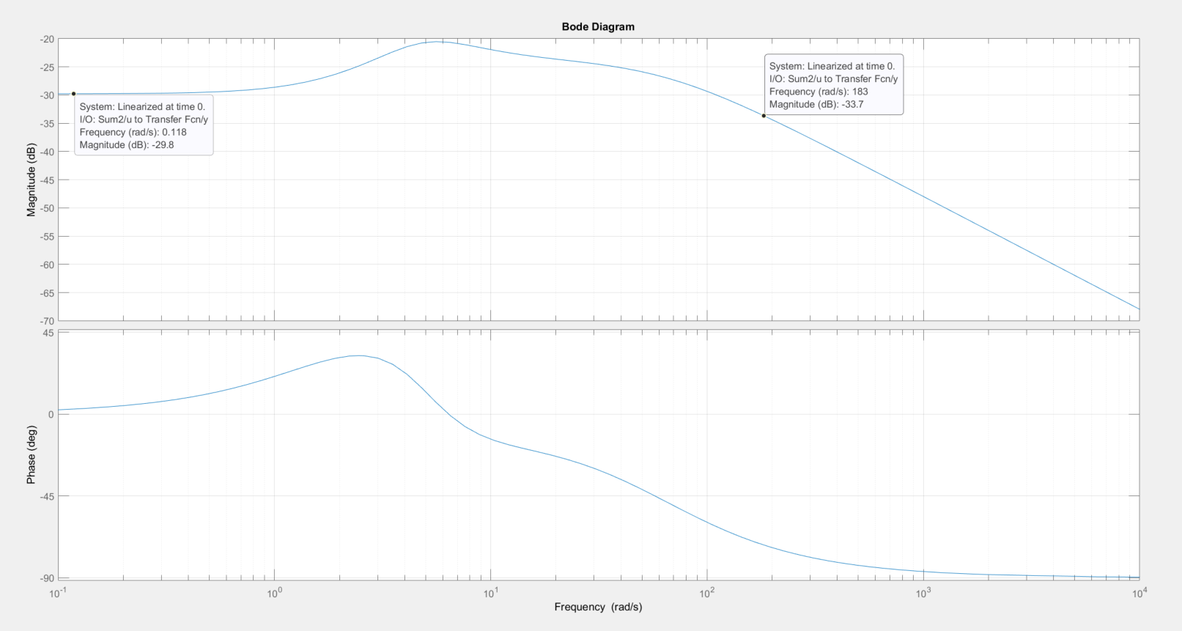
PPC – P2 – Frequency response

Slide 27
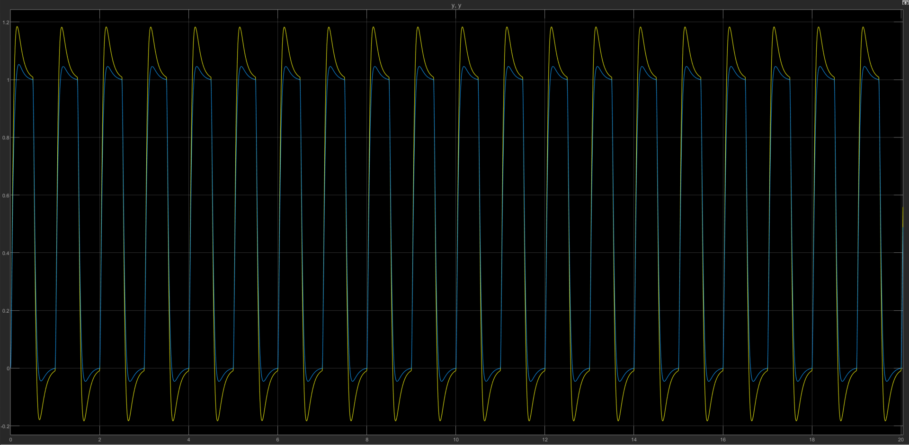
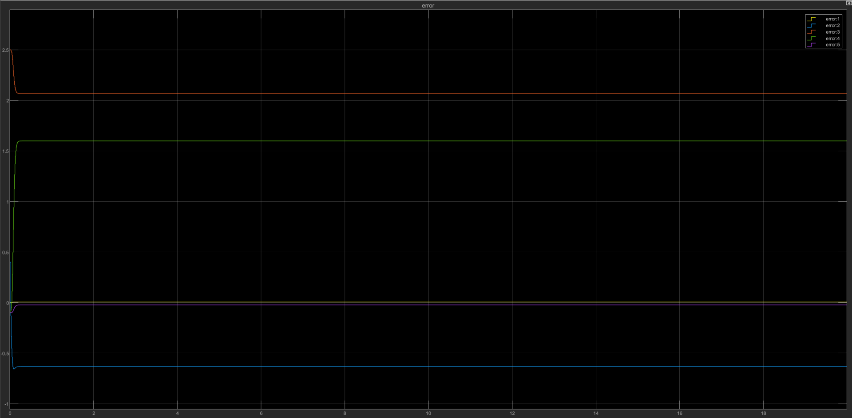
PPAC vs PPC comparison – Plant 2
I have tried various gamma for LS
algorithm, and they converge to
different parameters. If I set gamma
to be 1, the param would grow too fast
and the system would blow up.
Yp vs Yp fixed: does not converge
I have also attempted PRBS injection, with
frequency from 1Hz to 10 Hz, but none of them
helped the parameters to converge, even if they
altered the converged number a little bit.
Theta_error: stopped updating within 1 s

Slide 28
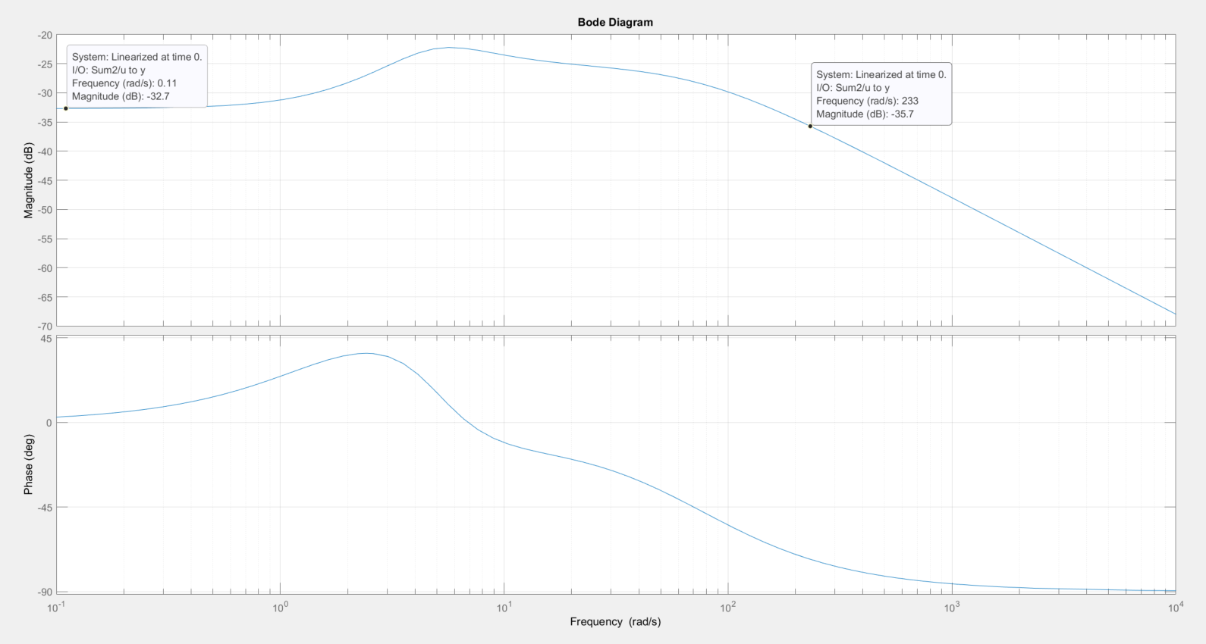
PPAC – P2 – Frequency response - adaptive
Bandwidth= 233
When designing this controller, I was attempting to have the system able to track the input. Therefore the high bandwidth

Slide 29
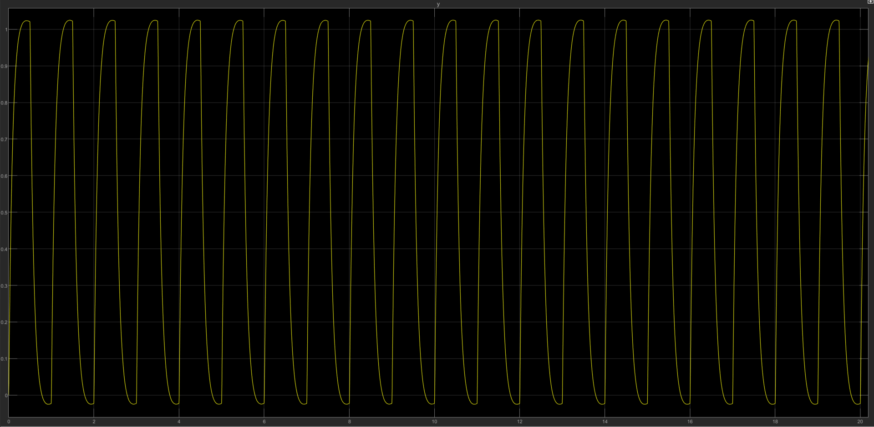
LQG – P2 – fixed - system response
KF: Q=R=10
Q = [100 0 0; 0 100 0; 0 0 1000]
R = 0.001

Slide 30
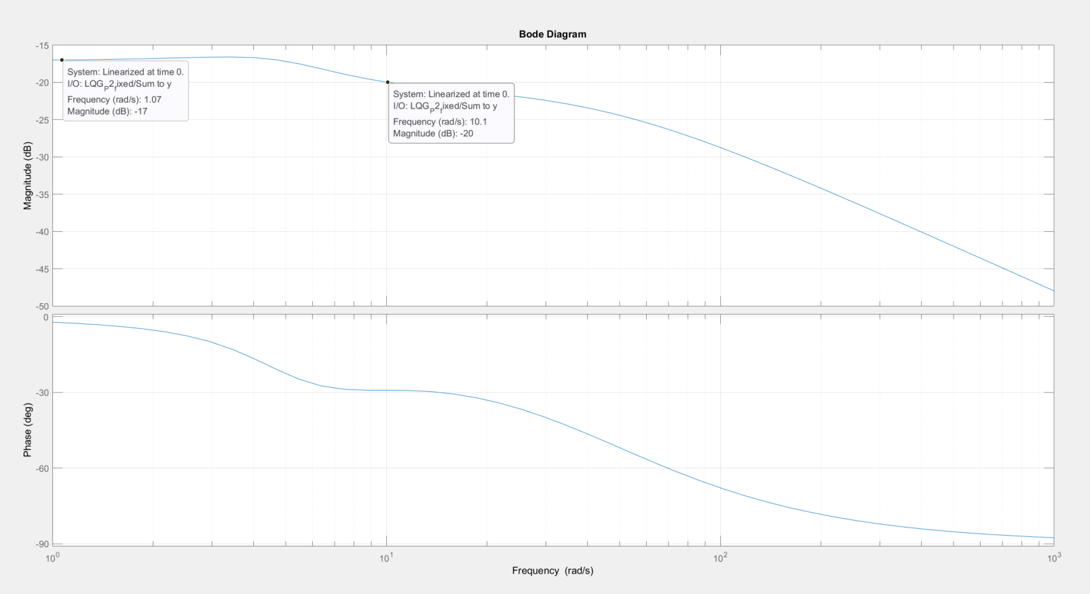
LQG – P2 – fixed - Frequency response
Bandwidth: 10

Slide 31
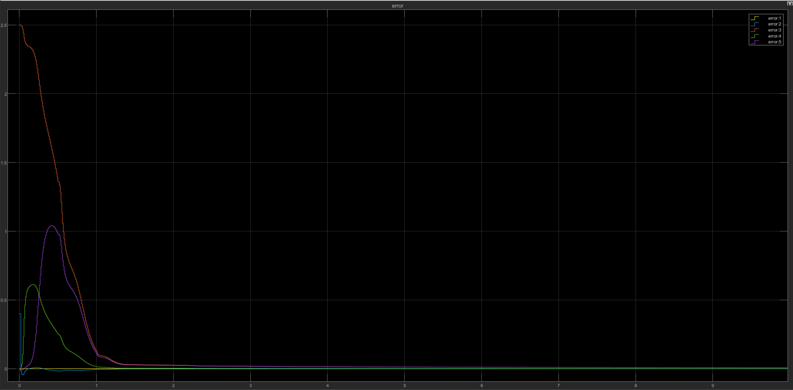
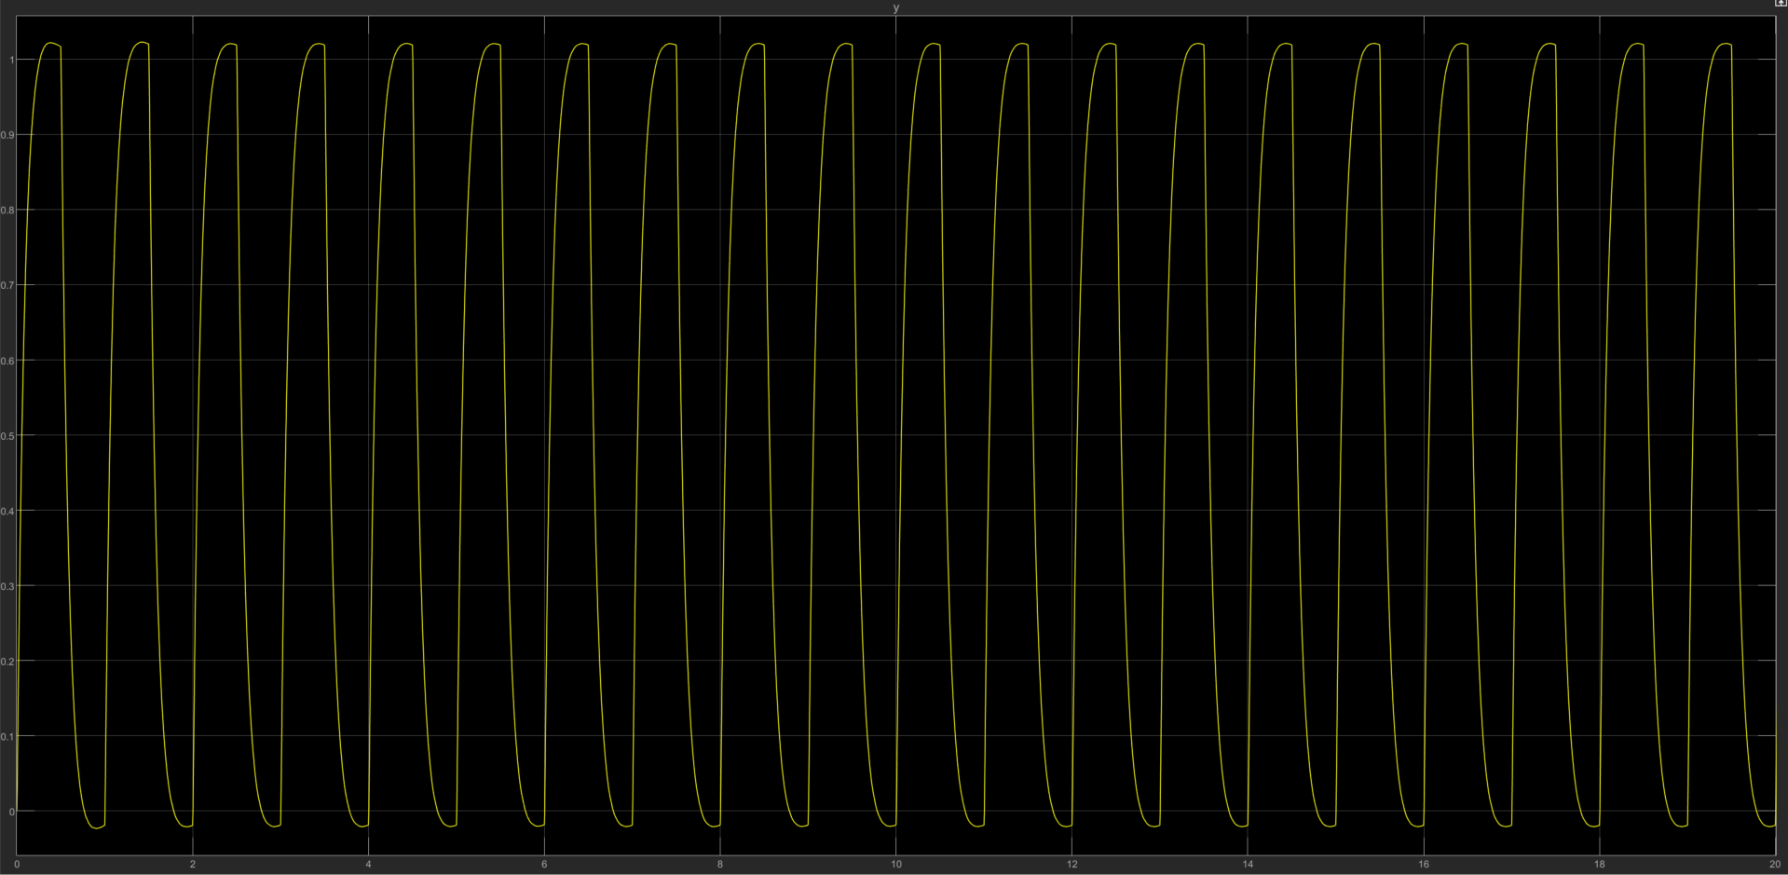
LQG – P2 – adaptive - system response
KF: Q=R=10
Q = [100 0 0; 0 100 0; 0 0 1000]
R = 0.001
Gamma = 1
Error converges

Slide 32
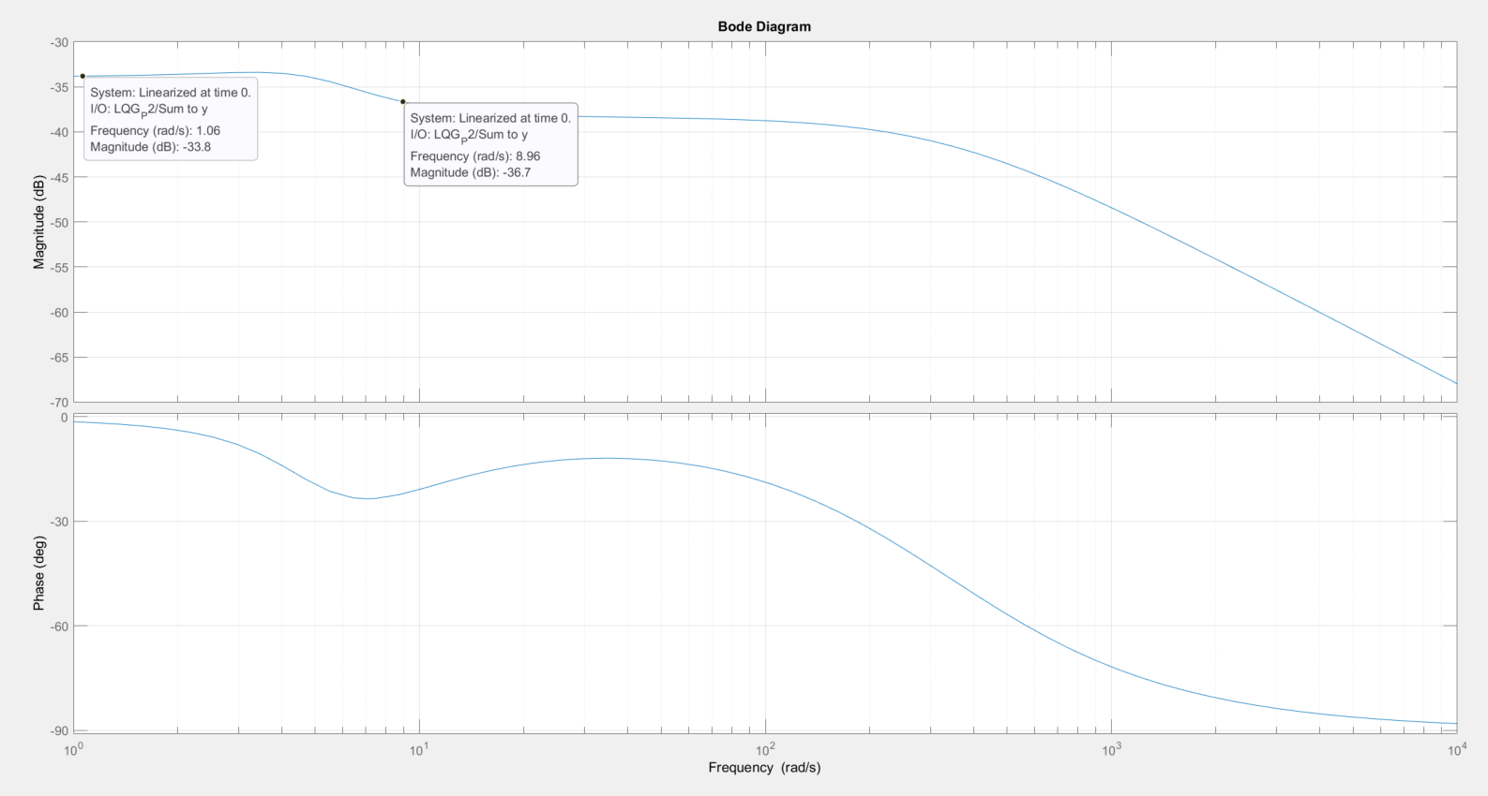
LQG – P2 – adaptive - Frequency response
Bandwidth: 9

Slide 33
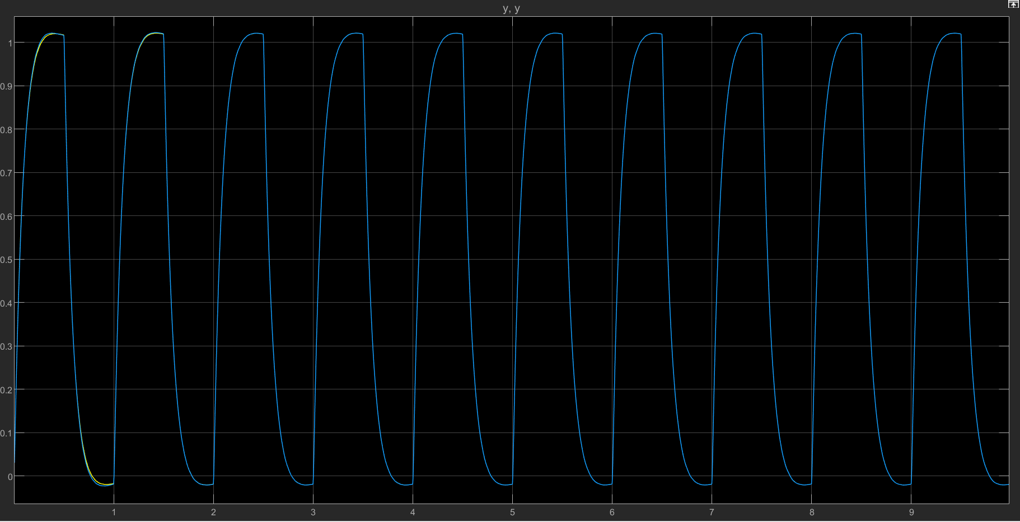
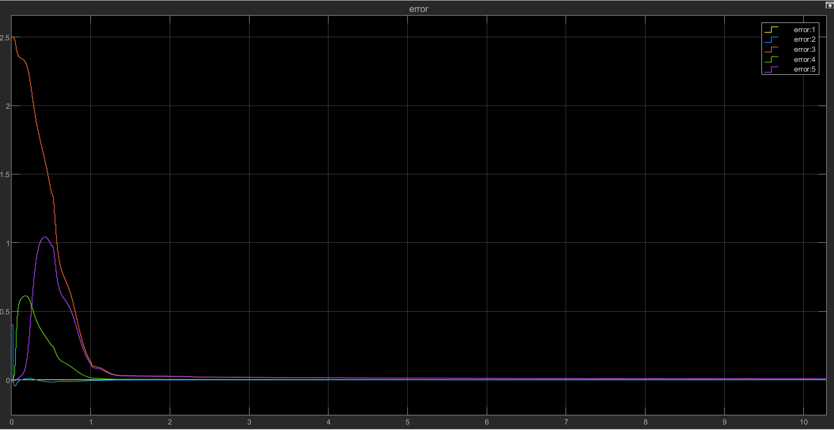
Adaptive LQG vs LQG comparison – Plant 2
Yp vs Yp fixed: converge within 2 seconds
Theta_error: converges in 2 seconds

Slide 34
Summary
We designed a fixed controller that tracks the reference input, then tested that the adaptive controllers converge to the fixed ones.
The adaptive controllers are able to converge to the fixed controller, with least square algorithm and 10% error from actual parameters.
The gain (gamma) for the least square algorithms had to be lowered by 10th order to prevent the system from blowing up.
Note that sometimes the system response might look right, but the actual parameters are incorrect. More study of the params that the algorithm converges to are required.

